Slide 1
Selective Unlearning in Face Recognition
Forgetting Faces without Sacrificing Accuracy
Authors
Adithyan M Nair - AM.EN.U4AIE20105
Akshit Sudheer Kumar - AM.EN.U4AIE20110
Devakrishna Sanil Kumar - AM.EN.U4AIE20119
Anjali T - Project Guide

Slide 2
Table of contents
01
02
03
04
05
06
Problem Statement
Methodology
Experimental Analysis
Conclusion
Paper Acceptance
References

Slide 3
01
Problem Statement

Slide 4
Problem Statement
The Problem
Our Solution
Facial recognition technology is increasingly being used in current applications ranging from smartphone unlocking to security and surveillance systems. This extensive adoption,
however, has generated severe concerns about individual privacy and data policies.
In response to these concerns, this study
introduces a novel methodology that gives people more control over their data in facial recognition systems. This study’s main
contribution is the proposal of a strategy for selectively unlearning certain faces from trained facial recognition algorithms.

Slide 5
Problem Statement
Example Use Case
Use Case Overview: This use case describes implementing a facial recognition system for employee access control and authentication while ensuring data removal for departing employees, respecting privacy, data protection regulations, and ethical data handling.
Use Case Steps:
User Account Creation: User accounts are created, and employee facial data is collected and stored.
Regular Authentication: Employees use facial recognition for daily access control and authentication.
End of Association: Removal of an employee's facial data is initiated upon departure.
Selective Unlearning Request: Employee informs about data removal decision.

Slide 6
Problem Statement
Example Use Case
5. Model Adaptation: The facial recognition model is adapted to unlearn departing employee's facial data.
6. Verification and Testing: The model is tested to ensure it doesn't recognize the departing employee but still works for others.
7. Secure Data Deletion: Employee's facial data is securely deleted, complying with regulations.
8. Post-Removal Verification: Confirmation of data removal.
9. Ongoing System Use: The system operates for remaining employees, with periodic updates and retraining to maintain accuracy and performance.

Slide 7
02
Methodology

Slide 8
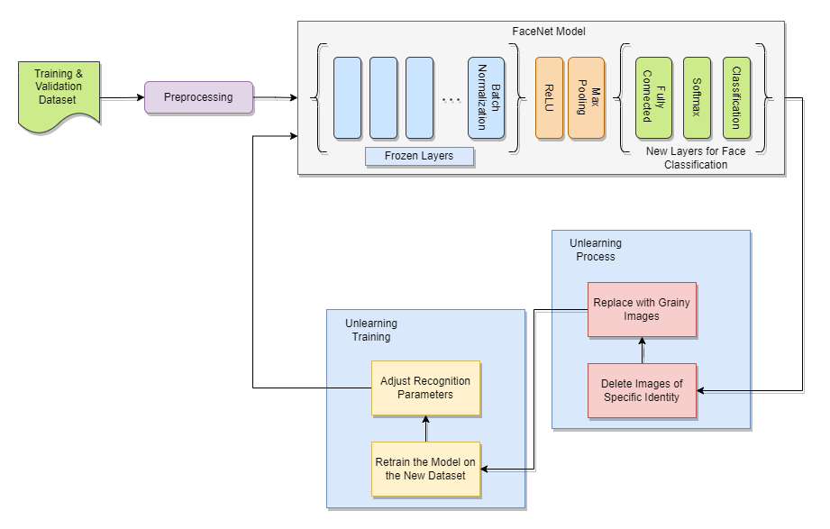
Methodology
Novel Approach
The proposed methodology includes the following key steps:
1. Model Training with Augmented Data:
Initially, train the face recognition model to recognize a set of target faces. The training dataset includes additional facial images that don't belong to the target set, forming a generalized category for all other faces.
The model architecture is shown in Fig. 1.

Slide 9
Methodology
Novel Approach
2. Unlearning Process:
To forget a specific identity, delete the images associated with it, mimicking a real-world scenario. Replace these images with grainy ones while maintaining the network structure.
3. Unlearning Training:
Retrain the model using the entire dataset, excluding the original target faces. During this phase, the model adjusts its recognition parameters to dissociate the specific face from the target faces. It also learns the grainy images, preserving the accuracy of the images that shouldn't be forgotten.

Slide 10
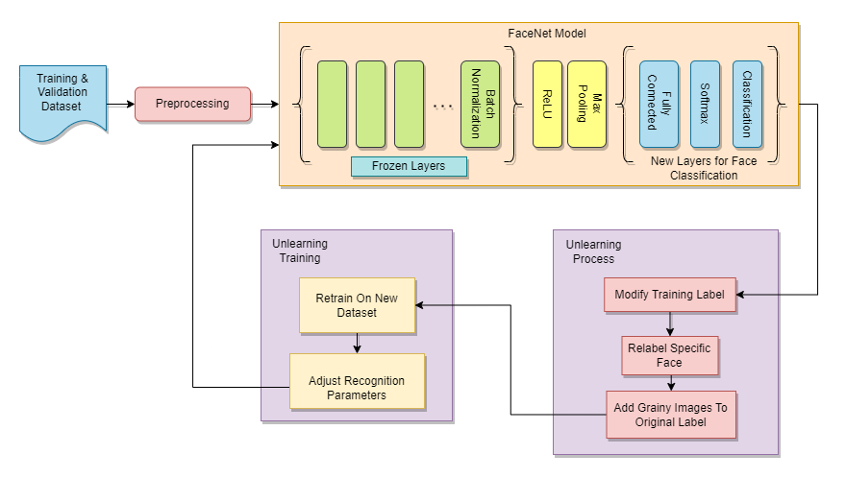
Methodology
Comparison Method
This study employs a method that involves pointing all the images of the identity to be forgotten to a set containing random unknown faces and retraining the model, serving as a comparison method. The process is as follows:
1. Model Training with Augmented Data:
Begin with the initial training of the face recognition model to recognize a set of target faces.
The training dataset includes additional facial images that don't belong to the target set. These images are labeled as a generalized class or category encompassing all faces outside the target set.

Slide 11
Methodology
Comparison Method
2. Unlearning Process:
For the specific face that needs to be forgotten, modify the model's training label to point to the generalized class instead of the individual's identity. This step effectively "relabels" the to-be-forgotten face as an unfamiliar or generalized one.
3. Unlearning Training:
Retrain the model using the entire dataset, excluding the original target faces. During this phase, the model adjusts its recognition parameters to dissociate the specific face from the target faces. It also learns the grainy images, preserving the accuracy of the images that shouldn't be forgotten

Slide 12
03
Experimental Analysis

Slide 13
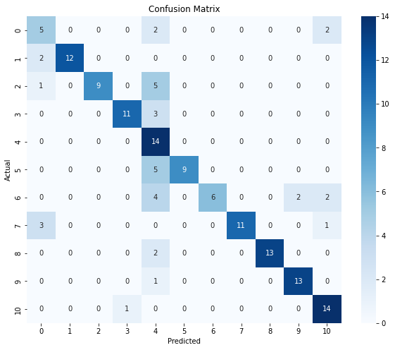
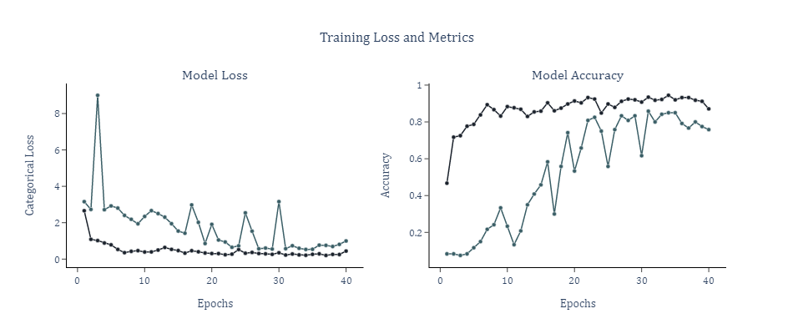
Experimental Analysis
Phase 1: Face Recognition
For the unlearning experiment, the Face Recognition model used is the FaceNet model. In this model, the last layer has been replaced with a fully connected layer, and it has been fine-tuned to recognize the selected faces from the DigiFace Dataset.
Fig. 3 illustrates the model's performance during the fine-tuning epochs, while Fig. 4 displays the performance of the model with no unlearning implemented.

Slide 14
Experimental Analysis
Phase 2: Unlearning
After fine-tuning and training the model on the selected 10 identities and a few random faces to act as unknown identities under the 0th identity, the next step is to forget or unlearn a specific identity, in this case, identity number 5 from the DigiFace dataset [3].
The proposed method involves the following steps:
1. Delete the images associated with identity 5.
2. Replace these images with grainy or noisy images.
3. Retrain the model for a few epochs.
Fig. 5 presents the confusion matrix of the model after applying the novel method for unlearning. The confusion matrix shows that the model has started to confuse images with the 5th identity's face as other identities, indicating that the 5th identity is gradually being forgotten by the model.
For contrast, the results of the comparison method mentioned, which simply relabels identity 5 as part of identity 0, are shown in Fig. 6.

Slide 15
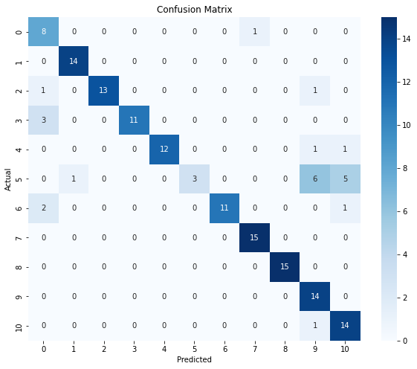
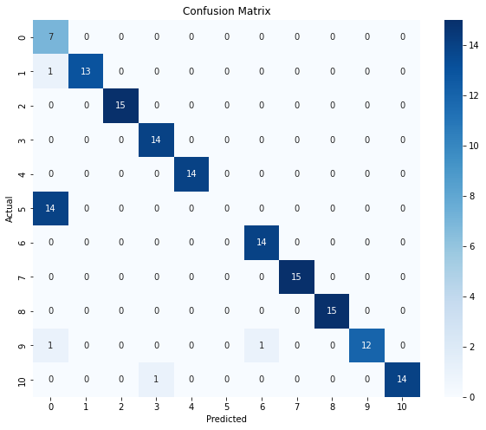
Experimental Analysis
Phase 2: Unlearning
Novel Approach Comparison Method

Slide 16
04
Usecase

Slide 17
Usecase Overview
Scenario:
An organization implements a facial recognition system for employee access control and authentication
Needs to ensure that individuals can selectively and securely remove their facial data from the system when their association with the organization ends.
Actors:
Employee
System Administrator
Facial Recognition System

Slide 18
Usecase Overview
Steps:
User Account Creation
Regular Authentication
End of Association
Selective Unlearning Request
Model Adaption
Verification and Testing
Secure Data Deletion
Post-Removal Verification
Ongoing System Use

Slide 19
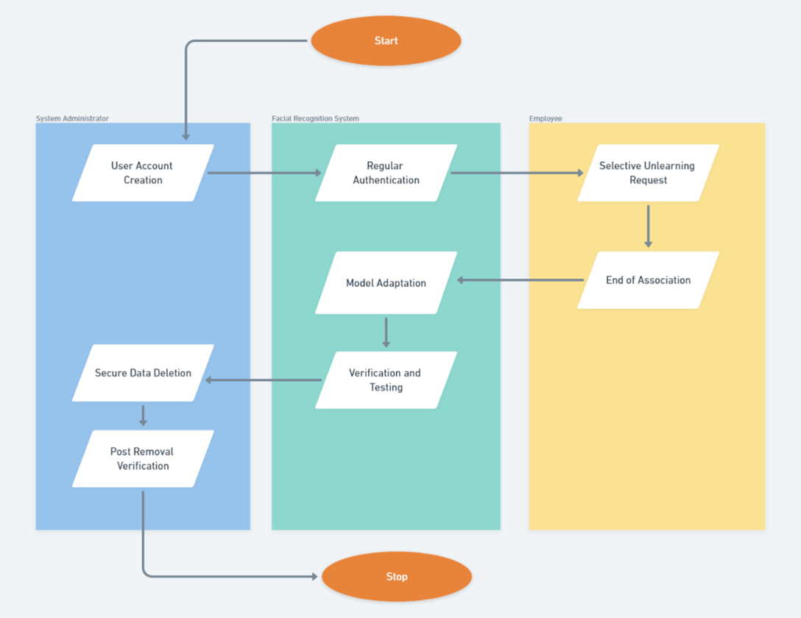
Usecase Diagram

Slide 20
05
Conclusion

Slide 21
Conclusion
This paper introduced and assessed a novel method for selectively unlearning faces from trained face recognition models. Using the DigiFace dataset, the study demonstrated the effectiveness of this approach.
By enriching the training data with unlabeled faces and selectively removing target faces during retraining, the method showed promise in "forgetting" specific identities from the model. This forgetting process was reinforced through retraining with noisy samples to replace the removed face images, effectively dissociating the face from recognized identities while maintaining overall accuracy.
In summary, this research contributes to the development of privacy-respecting facial recognition technology. Enabling the selective and secure removal of individuals' data empowers users to have more control over their biometric information and promotes ethical AI. With further refinement, this work has the potential to support the right to be forgotten in real-world face recognition applications.

Slide 22
06
Paper Acceptance Status

Slide 23
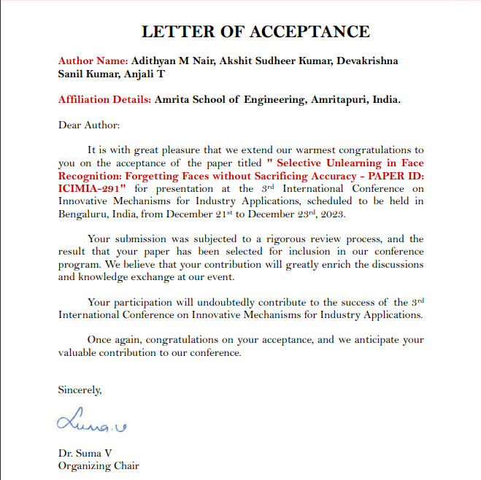
Status : Accepted

Slide 24
07
References

Slide 25
References
A. Majeed and S. O. Hwang, "When AI Meets Information Privacy: The Adversarial Role of AI in Data Sharing Scenario," in IEEE Access, vol. 11, pp. 76177-76195, 2023, doi: 10.1109/ACCESS.2023.3297646.
F. Schroff, D. Kalenichenko and J. Philbin, "FaceNet: A unified embedding for face recognition and clustering," 2015 IEEE Conference on Computer Vision and Pattern Recognition (CVPR), Boston, MA, USA, 2015, pp. 815-823, doi: 10.1109/CVPR.2015.7298682.
G. Bae, M. de La Gorce, T. Baltrusaitis, C. Hewitt, D. Chen, J. Valentin, R. Cipolla, and J. Shen, "DigiFace-1M: 1 Million Digital Face Images for Face Recognition," arXiv preprint arXiv:2210.02579, 2022.
P. S. Kumar and R. Ranjith, "Real Time Personal Data Protection Using Image Processing," 2021 12th International Conference on Computing Communication and Networking Technologies (ICCCNT), Kharagpur, India, 2021, pp. 1-5, doi: 10.1109/ICCCNT51525.2021.9579719.
G. Singh and A. K. Goel, "Face Detection and Recognition System using Digital Image Processing," 2020 2nd International Conference on Innovative Mechanisms for Industry Applications (ICIMIA), Bangalore, India, 2020, pp. 348-352, doi: 10.1109/ICIMIA48430.2020.9074838.
P. Yaswanthram and B. A. Sabarish, "Face Recognition Using Machine Learning Models - Comparative Analysis and impact of dimensionality reduction," 2022 IEEE Fourth International Conference on Advances in Electronics, Computers and Communications (ICAECC), Bengaluru, India, 2022, pp. 1-4, doi: 10.1109/ICAECC54045.2022.9716590.

Slide 26
References
Vikram S. Chundawat, Ayush K. Tarun, Murari Mandal, and Mohan Kankanhalli. 2023. "Zero-Shot Machine Unlearning." Trans. Info. For. Sec. 18 (2023), 2345–2354. https://doi.org/10.1109/TIFS.2023.3265506.
Y. Cao and J. Yang, "Towards Making Systems Forget with Machine Unlearning," 2015 IEEE Symposium on Security and Privacy, San Jose, CA, USA, 2015, pp. 463-480, doi: 10.1109/SP.2015.35.
Huawei Lin, Jun Woo Chung, Yingjie Lao, and Weijie Zhao. 2023. "Machine Unlearning in Gradient Boosting Decision Trees." In Proceedings of the 29th ACM SIGKDD Conference on Knowledge Discovery and Data Mining (KDD ’23). Association for Computing Machinery, New York, NY, USA, 1374–1383. https://doi.org/10.1145/3580305.3599420.
L. Bourtoule et al., "Machine Unlearning," 2021 IEEE Symposium on Security and Privacy (SP), San Francisco, CA, USA, 2021, pp. 141-159, doi: 10.1109/SP40001.2021.00019.
A. Krishnadas and S. Nithin, "A comparative study of machine learning and deep learning algorithms for recognizing facial emotions," 2021 Second International Conference on Electronics and Sustainable Communication Systems (ICESC), Coimbatore, India, 2021, pp. 1506-1512, doi: 10.1109/ICESC51422.2021.9532745.
A. Das and N. N, "Facial Expression Recognition System with Local Binary Features of Neural Network," 2023 International Conference on Data Science and Network Security (ICDSNS), Tiptur, India, 2023, pp. 1-5, doi: 10.1109/ICDSNS58469.2023.10244983.

Slide 27
References
V. C. R, V. Asha, B. Saju, S. N, T. R. Mrudhula Reddy and S. K. M, "Face Recognition and Identification Using Deep Learning," 2023 Third International Conference on Advances in Electrical, Computing, Communication and Sustainable Technologies (ICAECT), Bhilai, India, 2023, pp. 1-5, doi: 10.1109/ICAECT57570.2023.10118154.
W. Abbasi, P. Mori, A. Saracino and V. Frascolla, "Privacy vs Accuracy Trade-Off in Privacy Aware Face Recognition in Smart Systems," 2022 IEEE Symposium on Computers and Communications (ISCC), Rhodes, Greece, 2022, pp. 1-8, doi: 10.1109/ISCC55528.2022.9912465.
Zhang, H., Nakamura, T., Isohara, T. et al. "A Review on Machine Unlearning." SN COMPUT. SCI. 4, 337 (2023).
K. Vikram and S. Padmavathi, "Facial parts detection using Viola Jones algorithm," 2017 4th International Conference on Advanced Computing and Communication Systems (ICACCS), Coimbatore, India, 2017, pp. 1-4, doi: 10.1109/ICACCS.2017.8014636.
A. Stalin, A. Sha, A. S. Kumar, S. Nandakumar, and G. Gopakumar, "Face Recognition at varying angles from distant CCTV Footage using Siamese Architecture," 2022 3rd International Conference for Emerging Technology (INCET), Belgaum, India, 2022, pp. 1-6, doi: 10.1109/INCET54531.2022.9824723.

Slide 28
Thank You

